Slide 1
Valkyrie Turns Management System
Created By Damien Zucker, Connor Soran and Dustin Crager

Slide 2

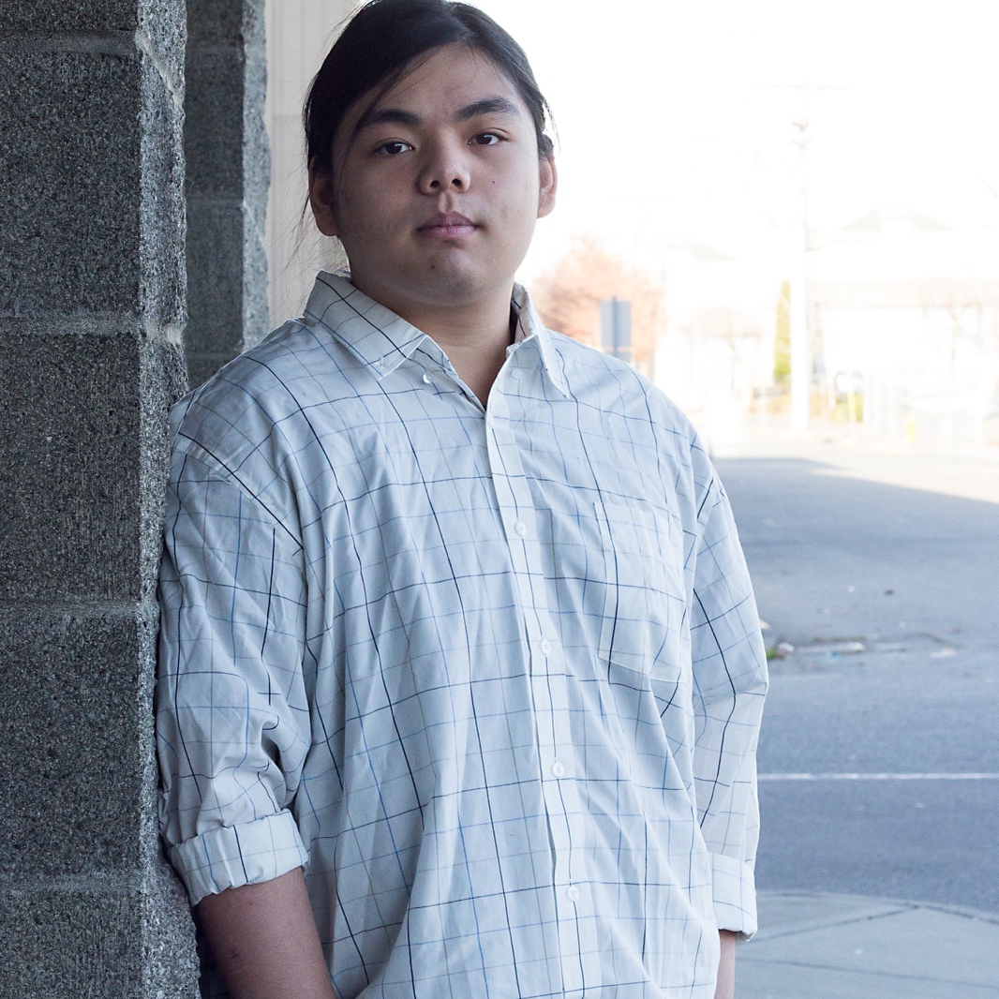
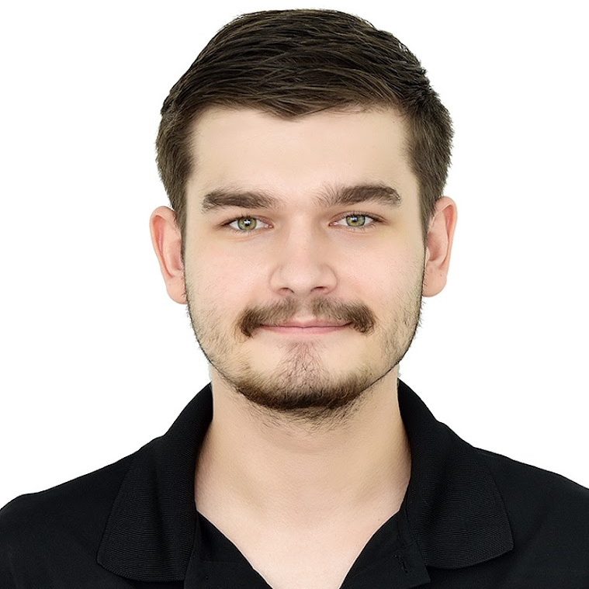
Team Introduction
Conor Soran
Damien Zucker
Dustin Dax Crager

Slide 3

What is the Purpose of our Project?
Our team was given the opportunity to create a professional site and schedule management system for a local business in Lakewood called Valkyrie Turns.
Our project aims to give Valkyrie Turns a reliable and efficient User management system, capable of identifying units for each subcontractor to turnover for a given day and other useful functions.
3

Slide 4
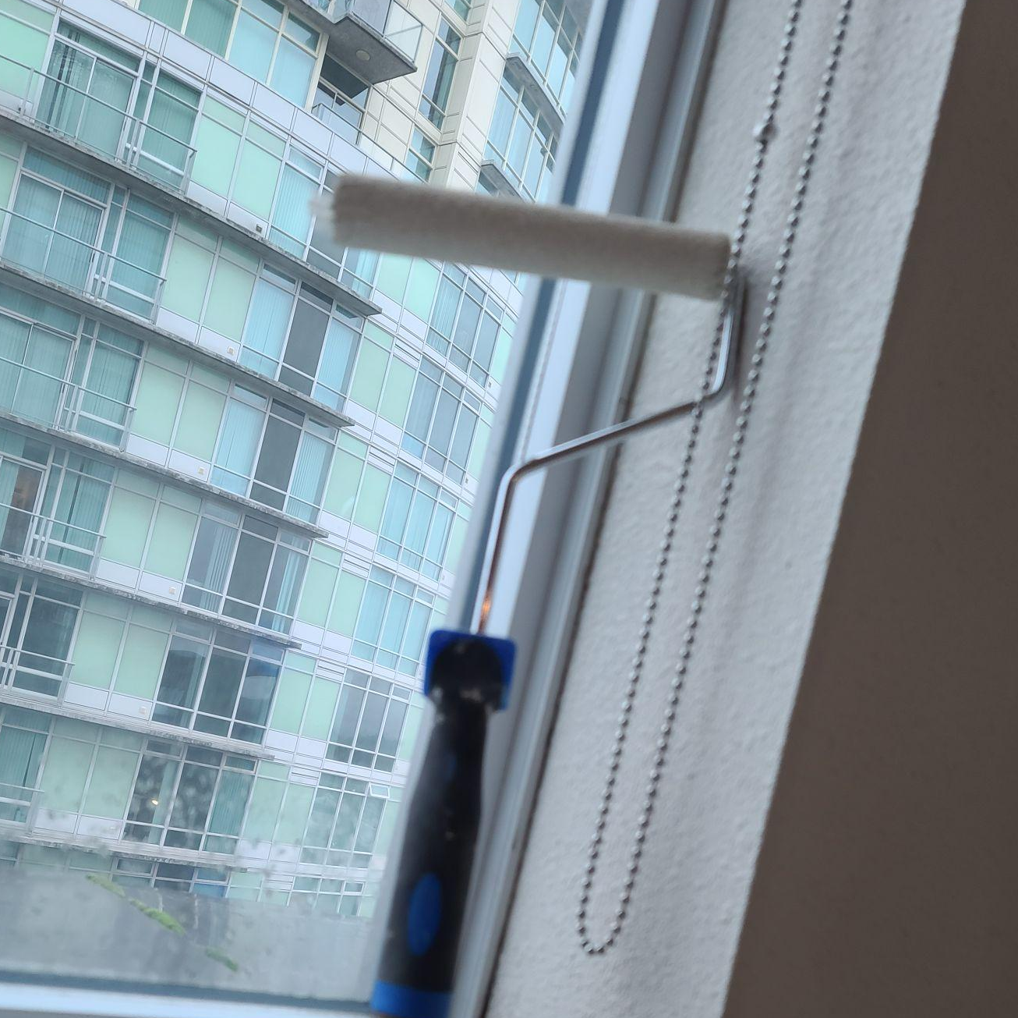
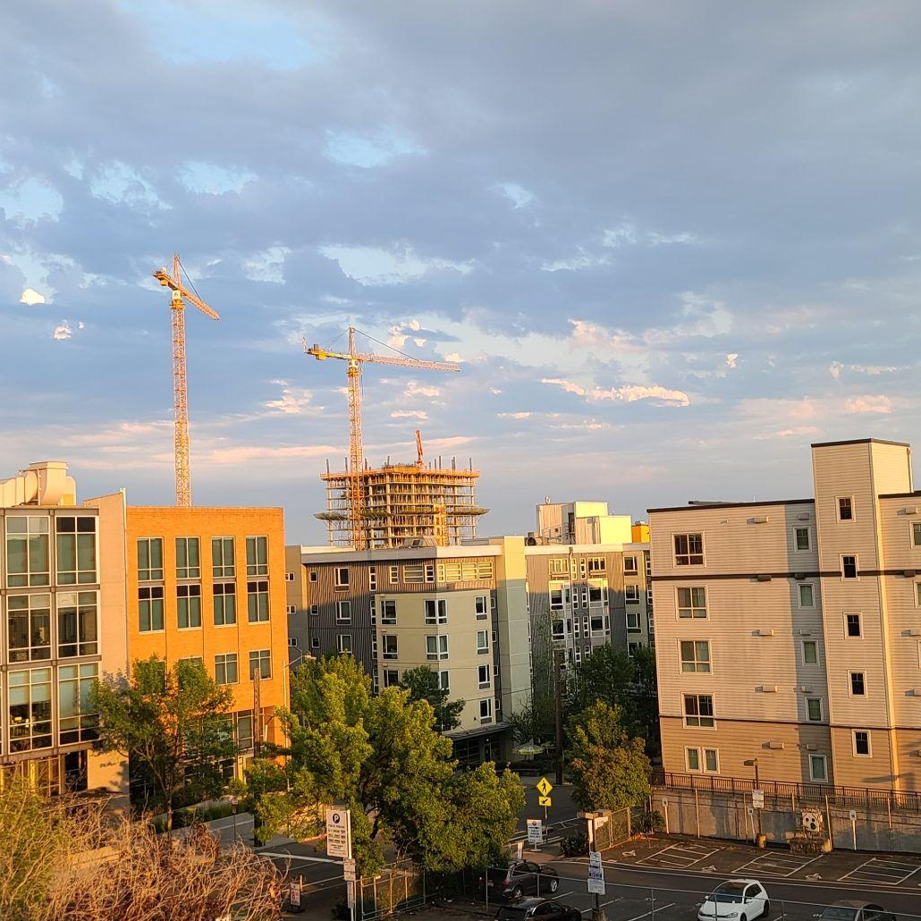
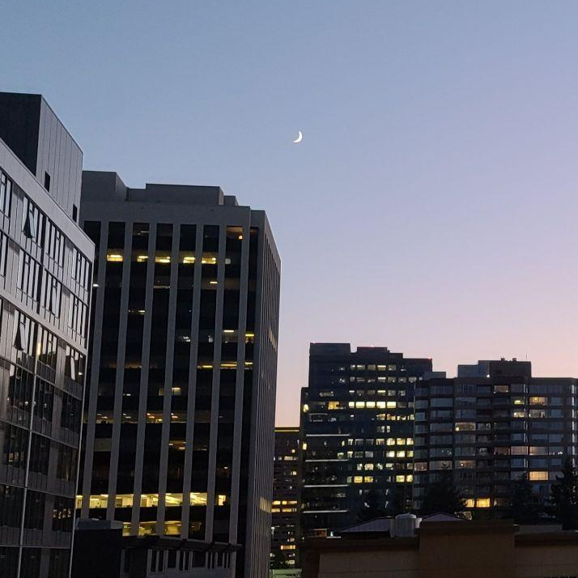
About Valkyrie Turns
Valkyrie Turns is a Apartment Turning business that operates in the greater Seattle area. They are formed of contractors who work on many different Apartment properties. These include Bellevue, Redmond, Seattle and Auburn area.

Slide 5
Features of the Application
Login System using PHP and MySQL
Accurate Schedule and Apartment Turn Tracking
Available Units
Subcontractor Payment Info
Information on Units
Professional and Informational website

Slide 6
Let’s review some concepts
Technologies
PHP
Allows for secure authentication for a login system when paired with MySQL.
HTML/CSS/JS
Fundamental Web-Based application languages used in construction of the application.
MySQL
The Database backbone for the project and saves user information.
AMAZON LIGHTSAIL
Easy secure server hosting solution with convenient and frequent backups and compatibility with MySQL.

Slide 7

Budget:
The Server will be hosted using Amazon Warehouse Services (AWS), which runs off of a recurring monthly payment. For this website,we will utilize the free 3-month trial during the construction of the project. If the client is satisfied with the finished product, they may continue to host the service for $8 a month using AWS Lightsail.
The construction of the project will come from the team’s skillset.
7

Slide 8
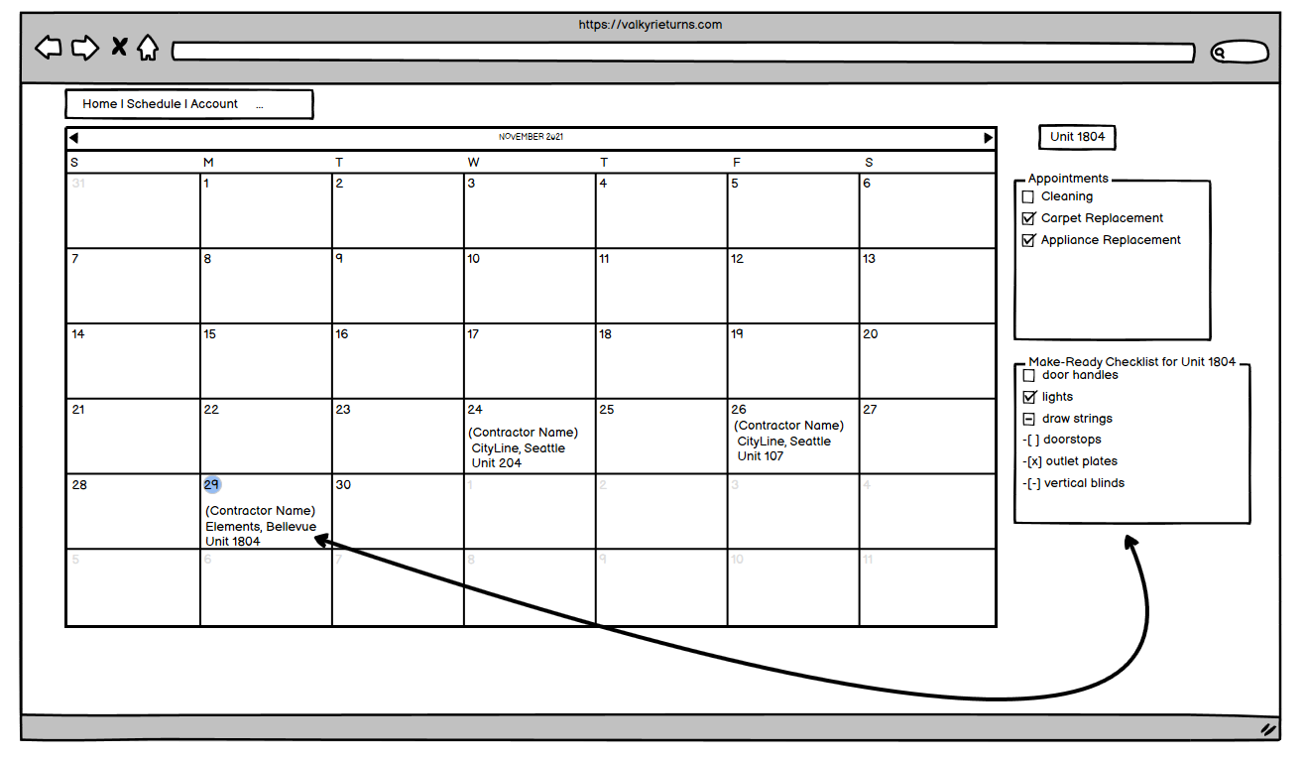
Visual Mockup of Schedule System

Slide 9
Project Schedule
Begin Construction of Base Website Technologies (HTML, CSS, JS, PHP)
Database Implementation and Connection to Main Site
Project is Completed and available for Client use.
JAN
FEB
MAR
APR
MAY
Database System Construction and Connection
Project Technologies are complete and Project Polishing and Fine Tuning begins

Slide 10

You can also split your content
Risks
IMPLEMENTATION
Valkyrie Turns currently runs its schedule using Outlook Calendars as a means to distribute apartment turns to contractors. The transition to the system will have to be smooth and without any hiccups to avoid any confusion.
EASE OF ACCESS
The system must be intuitive and easy to use, and avoid confusion by allowing the schedule to be easy to assign to contractors and easy to understand for the sub-contractors.

Slide 11
In two or three columns
Whats Next?
COMMUNICATION
The client will be involved with each iteration of the project to make sure everything is tailored to their needs.
CONSTRUCTION
Our Team will divide tasks and work on each section of the application to ensure quality is delivered.
QUALITY
Since this will be Valkyrie Turns first exposure as a new start-up, we want to create the best quality site for their start.

Slide 12
Thank you for watching!

